Slide 1







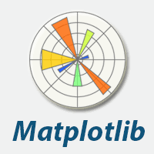


Introduction to Data Science Using Python

Slide 2
Day_2
Data Manipulation : Pandas
Data Visualization:
Matplotlib
Seaborn
Plotly

Slide 3
Datasets Manipulation : Pandas
Introduction to Pandas: DataFrames
Data Loading , and Exploring
Selecting Data: Indexing, Slicing and Boolean filtering.
Data Cleaning and Preprocessing Techniques
Handling Missing Values
Dealing with Duplicates
Detecting and handling outliers in the data.
Data Wrangling: Merging, Joining, and Reshaping Data
Sorting Data: Arranging data in ascending or descending order based on a specific column.
Grouping and Aggregation: Performing calculations (sum, mean, count) on groups of data based on certain criteria.

Slide 4
Pandas
Python Library to provide data analysis features similar to: R, MATLAB,
The most important package for the data analysis with Python.
Rich data structures and functions to make working with data structure fast, and easy.
It is built on top of NumPy
Key components provided by Pandas:
Series
DataFrame
The fundamental concept of Pandas package is the DataFrame, a two-dimensional tabular data structure, with row and column labels.

Slide 5
Series
One dimensional “array”
It contains array of data with associated indexes. (Indexes can be strings or integers or other data types.)
By default , the series will be indexed from 0 to size -1
import pandas as pd
a = pd.Series([4, 7, -5, 3])
print(a)
print(a.index)
print(a.values)
b = pd.Series([4, 7, -5, 3], index=['d', 'b', 'a', 'c'])
print(b)
#Output
d 4
b 7
a -5
c 3
dtype: int64
print(b.index)
#Output
Index(['d', 'b', 'a', 'c'], dtype='object')
print(b.values)
#Output
[ 4 7 -5 3]
print(b['a'])
#Output
-5
#Output
0 4
1 7
2 -5
3 3
dtype: int64
RangeIndex(start=0, stop=4, step=1)
[ 4 7 -5 3]

Slide 6
DataFrame
A DataFrame is a tabular data structure comprised of rows and columns, similar to a spreadsheet or database table.
It can be treated as an ordered collection of columns
Each column can be a different data type
data = { 'state': ['Ohio', 'Ohio', 'Ohio', 'Nevada', 'Nevada'],
'year': [2000, 2001, 2002, 2001, 2002],
'popl': [1.5, 1.7, 3.6, 2.4, 2.9] }
frame = pd.DataFrame(data)
print(frame)
#output
state year popl
0 Ohio 2000 1.5
1 Ohio 2001 1.7
2 Ohio 2002 3.6
3 Nevada 2001 2.4
4 Nevada 2002 2.9
frame2 = pd. DataFrame(data, columns=['year', 'state', 'popl', 'debt'],
index=['A', 'B', 'C', 'D', 'E'])
Print(frame2)
year state pop debt
A 2000 Ohio 1.5 NaN
B 2001 Ohio 1.7 NaN
C 2002 Ohio 3.6 NaN
D 2001 Nevada 2.4 NaN
E 2002 Nevada 2.9 NaN

Slide 7
DataFrame – Retrieving a column
A column in a DataFrame can be retrieved as a Series by two possible notations:
dataframe[“namecol”] or dataframe.namecol
data = { 'state': ['Ohio', 'Ohio', 'Ohio', 'Nevada', 'Nevada'],
'year': [2000, 2001, 2002, 2001, 2002],
'popl': [1.5, 1.7, 3.6, 2.4, 2.9] }
frame = pd.DataFrame(data)
print(frame['state'])
0 Ohio
1 Ohio
2 Ohio
3 Nevada
4 Nevada
Name: state, dtype: object
print(frame.state)
0 Ohio
1 Ohio
2 Ohio
3 Nevada
4 Nevada
Name: state, dtype: object

Slide 8
DataFrame –Retrieving rows
loc for using indexes /columns and iloc for using integers position: using the dataframe as a matrix.
data = { 'state': ['Ohio', 'Ohio', 'Ohio', 'Nevada', 'Nevada'],
'year': [2000, 2001, 2002, 2001, 2002],
'popl': [1.5, 1.7, 3.6, 2.4, 2.9] }
frame2 = pd.DataFrame(data, columns=['year', 'state', 'pop', 'debt'], index=['A', 'B', 'C', 'D','E'])
print(frame2)
year state pop debt
A 2000 Ohio 1.5 NaN
B 2001 Ohio 1.7 NaN
C 2002 Ohio 3.6 NaN
D 2001 Nevada 2.4 NaN
E 2002 Nevada 2.9 NaN
print(frame2.loc['A'])
year 2000
state Ohio
pop 1.5
debt NaN
Name: A, dtype: object
print(frame2.loc[['A', 'B']])
year state pop debt
A 2000 Ohio 1.5 NaN
B 2001 Ohio 1.7 NaN
print(frame2.iloc[1,2])
1.7

Slide 9
Data Frames: Slicing
There are a number of ways to subset the Data Frame:
one or more columns
one or more rows
a subset of rows and columns
Rows and columns can be selected by their position or label
data = { 'state': ['Ohio', 'Ohio', 'Ohio', 'Nevada', 'Nevada'],
'year': [2000, 2001, 2002, 2001, 2002],
'popl': [1.5, 1.7, 3.6, 2.4, 2.9] }
frame2 = pd.DataFrame(data, columns=['year', 'state', 'pop', 'debt'],
index=['A', 'B', 'C', 'D','E'])
print(frame2)
year state popl debt
A 2000 Ohio 1.5 NaN
B 2001 Ohio 1.7 NaN
C 2002 Ohio 3.6 NaN
D 2001 Nevada 2.4 NaN
E 2002 Nevada 2.9 NaN
print(frame2.iloc[1:3])
year state popl debt
B 2001 Ohio 1.7 NaN
C 2002 Ohio 3.6 NaN
print(frame2.iloc[:,1:3])
state popl
A Ohio 1.5
B Ohio 1.7
C Ohio 3.6
D Nevada 2.4
E Nevada 2.9
print(frame2.loc['A':'E',['state','popl']])
state popl
A Ohio 1.5
B Ohio 1.7
C Ohio 3.6
D Nevada 2.4
E Nevada 2.9

Slide 10
DataFrames: Method iloc
df.iloc[0] # First row of a data frame
df.iloc[i] #(i+1)th row
df.iloc[-1] # Last row
df.iloc[:, 0] # First column
df.iloc[:, -1] # Last column
df.iloc[0:7] #First 7 rows
df.iloc[:, 0:2] #First 2 columns
df.iloc[1:3, 0:2] #Second through third rows and first 2 columns
df.iloc[[0,5], [1,3]] #1st and 6th rows and 2nd and 4th columns

Slide 11
Data Loading
Read csv file
import pandas as pd
df =pd.read_csv(“filename.csv")
Many other Pandas commands to read other data formats:
Read xlsx
pd.read_excel('file.xlsx',sheet_name='Sheet1’)

Slide 12
Exploring : DataFrames methods
df.method() | description
head( n ) tail( n ) | First n rows last n rows
describe() | generate descriptive statistics (for numeric columns only)
max(), min() | return max/min values for all numeric columns
mean(), median() | return mean/median values for all numeric columns
std() | standard deviation
sample(n) | returns a random sample of the data frame
dropna() | drop all the records with missing values

Slide 13
Exploring : DataFrames attributes
df.attribute | description
dtypes | list the types of all the columns
columns | list the column names
axes | list the row labels and column names
ndim | number of dimensions
size | number of elements
shape | return a tuple representing the dimensionality

Slide 14
DataFrame: Boolean filtering
For example if we want to subset the rows in which the popl value is greater than 2.5:
filt_df= frame1[ frame1[’popl’] > 2.5 ]
Any operator can be used to subset the data:
> ; >= ; < ; <= ; == ; !=
Boolean operators are | ~ &

Slide 15
Filtering
print(frame)
c1 c2 c3
r1 0 1 2
r2 3 4 5
r3 6 7 8
print(frame <3)
c1 c2 c3
r1 True True True
r2 False False False
r3 False False False
print(frame[frame['c1']>0])
c1 c2 c3
r2 3 4 5
r3 6 7 8
print(frame['c1']>0)
r1 False
r2 True
r3 True
Name: c1, dtype: bool
frame[frame<3] = 3
print(frame)
c1 c2 c3
r1 3 3 3
r2 3 4 5
r3 6 7 8

Slide 16
Removing rows/columns
print(frame)
c1 c2 c3
r1 0 1 2
r2 3 4 5
r3 6 7 8
print(frame.drop(['r1']))
c1 c2 c3
r2 3 4 5
r3 6 7 8
print(frame.drop(['r1','r3']))
c1 c2 c3
r2 3 4 5
print(frame.drop(['c1'], axis=1))
c2 c3
r1 1 2
r2 4 5
r3 7 8
axis=0 for rows # by default
axis=1 for columns

Slide 17
Missing Values
Missing values are marked as NaN
There are a number of methods to deal with missing values in the DataFrame:
df.method() |  | description
dropna() |  | Drop missing observations (if at least one in row)
dropna(how='all') |  | Drop observations (rows) where all cells is NA
dropna(axis=1, how='all') |  | Drop column if all the values are missing
dropna(thresh = 5) |  | Drop rows that contain less than 5 non-missing values
fillna(0) , fillna((val) |  | Replace missing values with zeros, with val
isnull() |  | returns True if the value is missing
notnull() |  | Returns True for non-missing values
skipna=True/False |  | are NaN values kipped when calculating some descriptive statistics parameter : example:data.mean(skipna=True)

Slide 18
Filling in missing data - Examples
print(data)
0 1 2 4
0 1.0 2.0 3.0 NaN
1 1.0 NaN NaN NaN
2 NaN NaN NaN NaN
NaN 4.0 5.0 NaN
print(data.fillna(0))
0 1 2 4
0 1.0 2.0 3.0 0.0
1 1.0 0.0 0.0 0.0
2 0.0 0.0 0.0 0.0
3 0.0 4.0 5.0 0.0
print(data)
0 1 2
0 1.0 2.0 3.0
1 1.0 NaN NaN
2 NaN NaN NaN
3 NaN 4.0 5.0
print(data.fillna(data.mean(skipna=True)))
0 1 2
0 1.0 2.0 3.0
1 1.0 3.0 4.0
2 1.0 3.0 4.0
3 1.0 4.0 5.0
print(data.fillna(0, inplace=True))
print(data)
0 1 2 4
0 1.0 2.0 3.0 0.0
1 1.0 0.0 0.0 0.0
2 0.0 0.0 0.0 0.0
3 0.0 4.0 5.0 0.0
Cleaning Data:
# Fill missing values in the 'email' column with 'NA'
data["email"] = data["email"].fillna("NA")

Slide 19
Dealing with duplicate
Use drop_duplicates () to remove the duplicates ; keep = ‘first’ , ‘last’ or False
Name Age Grade Attendance
0 Alice 20 85 95
1 Bob 22 90 92
2 Charlie 21 78 88
3 David 23 92 93
4 Alice 20 85 95
5 Eva 19 88 96
6 Bob 22 90 92
Name Age Grade Attendance
2 Charlie 21 78 88
3 David 23 92 93
5 Eva 19 88 96
import pandas as pd
students_data = {
'Name': ["Alice", "Bob", "Charlie", "David", "Alice", "Eva", "Bob"],
'Age': [20, 22, 21, 23, 20, 19, 22],
'Grade': [85, 90, 78, 92, 85, 88, 90],
'Attendance': [95, 92, 88, 93, 95, 96, 92] }
students_df = pd.DataFrame(students_data)
print(students_df)
# Remove all duplicate rows
students_df_no_duplicates = students_df.drop_duplicates(keep=False)
print(students_df_no_duplicates)

Slide 20
Detecting and Handling outliers in the data : What is an outlier?.
Outliers are the extreme values within the dataset.
That means the outlier data points vary greatly from the expected values—either being much larger or significantly smaller.
Outliers can find their way into a dataset naturally through variability, or they can be the result of errors,
Outliers can have a big impact on statistical analysis and machine learning because they impact calculations like mean and standard deviation, and they can skew hypothesis tests.

Slide 21
Finding outliers using statistical methods : Z-scores or IQR
Using the IQR, the outlier data points are the ones falling below Q1–1.5 *IQR or above Q3 + 1.5 *IQR.
The Q1 is the 25th percentile and Q3 is the 75th percentile of the dataset, and IQR represents the interquartile range calculated by (Q3–Q1).
Using pandas .quantile() function, we can identify the outliers: df could be a DataFrame or one column
Q1=df.quantile(0.25)
Q3=df.quantile(0.75)
IQR=Q3-Q1
lowlim= Q1-1.5*IQR
highlim= Q3+1.5*IQR
outliers = df[(df<lowlim) | (df> highlim )]
not_outliers = df[~((df<lowlim) | (df>highlim))]
outliers_dropped = outliers.dropna()

Slide 22
Data Wrangling: Merging, Joining, and Reshaping Data
res1 = pd.concat([df, df1])
by default axis=0
df1 = pd.DataFrame({'A': [1, 2, 3], 'B': [4, 5, 6]})
df2 = pd.DataFrame({'A': [4, 5], 'B': [7, 8]})
# Concatenate the DataFrames along the rows
df_concat = pd.concat([df1, df2], axis=0)
print(df_concat)
A B
0 1 4
1 2 5
2 3 6
0 4 7
1 5 8

Slide 23
Concatenation columns concat axis=1
Name Age Gender
0 John 24 M
1 Jack 32 M
2 Steve 19 M
3 Sarah 29 F
Department Employees
0 Marketing 15
1 Sales 12
2 Human Resources 10
# Concatenating horizontally
df4 = pd.concat([df1, df2], axis=1)
Name Age Gender Department Employees
0 John 24 M Marketing 15
1 Jack 32 M Sales 12
2 Steve 19 M Human Resources 10
3 Sarah 29 F NaN NaN

Slide 24
Dataframes intersection
pd.merge(df1, df2, how)
import pandas as pd
# Creating Data frames
df1 = {'A': [1, 2, 3, 4],
'B': ['abc', 'def', 'efg', 'ghi']}
df2 = {'A': [1, 2, 3, 4 ],
'B': [‘ttt', ‘nnn', 'efg', 'ghi'],
'C':[‘Al', ‘Na', ‘H2', ‘Fe’]}
d1 = pd.DataFrame(df1)
d2 = pd.DataFrame(df2)
int_df = pd.merge(d1, d2, how ='inner', on =['A', 'B'])
print(int_df)
A B C
0 3 efg H2
1 4 ghi Fe

Slide 25
DataFrames Joining
we use .join() method to join dataframes on index
res = dfleft.join(dfright)
df1:
A B
x 1 4
y 2 5
z 3 6
df2:
C D
y 7 10
z 8 11
w 9 12
df_joined:
A B C D
y 2 5 7 10
z 3 6 8 11
df1 = pd.DataFrame({'A': [1, 2, 3], 'B': [4, 5, 6]},
index=['x', 'y', 'z'])
df2 = pd.DataFrame({'C': [7, 8, 9], 'D': [10, 11, 12]},
index=['y', 'z', 'w'])
print(df1)
print(df2)
# Join the DataFrames using an inner join
df_joined = df1.join(df2, how='inner')
print(df_joined)

Slide 26
Reindexing reshaping
Alter the order of rows/columns of a DataFrame or order of a series according to new index
frame2 = frame.reindex(columns=['c2', 'c3', 'c1'])
print(frame2)
c2 c3 c1
r1 1 2 0
r2 4 5 3
r3 7 8 6
frame2 = frame.reindex(['r1', 'r3', 'r2', 'r4'])
c1 c2 c3
r1 0.0 1.0 2.0
r3 6.0 7.0 8.0
r2 3.0 4.0 5.0
r4 NaN NaN NaN
This returns a new object

Slide 27
Sorting Data: On a specific column.
We can sort the data by a value in the column. By default the sorting will occur in ascending order and a new data frame is return.
# Create a new data frame from the original sorted by the column Salary
df_sorted = df.sort_values( by =‘Salary')
We can sort the data using 2 or more columns:
df_sorted = df.sort_values( by =['service', 'salary'], ascending = [True, False])

Slide 28
Data Frames groupby method and aggregation
Using "group by" method we can:
Split the data into groups based on some criteria
Calculate statistics (or apply a function) to each group , .mean() , .sum() , .count() .agg()
import pandas as pd
data = {
'Animal': ['Falcon', 'Falcon', 'Parrot', 'Parrot'],
'Max Speed': [380.0, 370.0, 24.0, 26.0]
}
df = pd.DataFrame(data)
grouped_df = df.groupby(['Animal']).agg({'Max Speed': ['mean', 'sum']})
Animal Max Speed (mean) Max Speed (sum)
Falcon 375.0 750.0
Parrot 25.0 50.0
Animal MaxSpeed
Falcon 380
Falcon 370
Parrot 24.0
Parrot 26.0
grouped_df = df.groupby(['Animal']).mean()
Animal Max Speed
Falcon 375.0
Parrot 25.0

Slide 29
Basic Descriptive Statistics aggregation
df.method() | description
describe | Basic statistics (count, mean, std, min, quantiles, max)
min, max | Minimum and maximum values
mean, median, mode | Arithmetic average, median and mode
var, std | Variance and standard deviation
sem | Standard error of mean
skew | Sample skewness
kurt | kurtosis

Slide 30
Data Visualization
Importance of Data Visualization: Effectively communicating insights and patterns hidden within data.
Different Types of Data Visualizations: Scatter plots, histograms, bar charts, line charts, boxplots, and more, each suited for different data types and purposes.
Matplotlib Introduction to Matplotlib: Visualizing Data Distributions , Creating Effective Charts and Graphs, Creating Plots, Customization, and Saving Figures
Creating Basic Plots: Generating scatter plots, histograms, and bar charts using Matplotlib functions.
Customizing Plots: Adding titles, labels, legends, and adjusting plot aesthetics for better readability.
Seaborn- Data Visualization with Seaborn: Exploratory Data Analysis, Statistical Visualization
Exploring Seaborn Functionalities: Creating distribution plots, heatmaps, jointplots, and other advanced visualizations.
Plotly : interactive visualization

Slide 31

Data Visualization : Matplotlib
This package is the Python library that is (was) the most popular for producing plots and other data visualizations in 2D.
import matplotlib
from matplotlib import pyplot as plt
Or :
import matplotlib.pyplot as plt

Slide 32
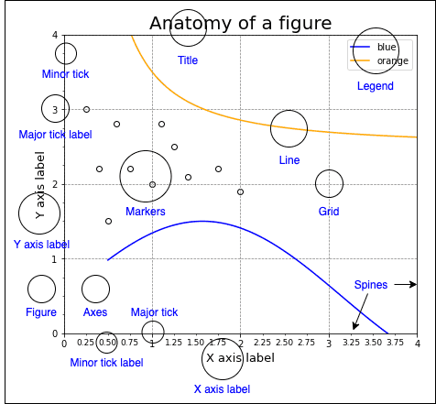
Matplotlib figures
Types of plots :
Line plots
Bar plots
Scatter plots
Box plots
Histograms
Heatmaps
…

Slide 33
Line plot
Used for numeric data
Used to show trends
Compare two or more different variables over time
Could be used to make predictions
import matplotlib.pyplot as plt
x = [1, 2, 3]
y = [1, 4, 5]
plt.plot(x, y)
plt.title("Simple Line ")
# Adding the legends
plt.legend(["FirstLine"])
plt.show()

Slide 34
Bar plots
Compare data amongst different categories
Ideal for more than 3 categories
Can show large data changes over time
import matplotlib.pyplot as plt
# data to display on plots
x = [3, 1, 3, 12, 2, 4, 4]
y = [3, 2, 1, 4, 5, 6, 7]
# This will plot a simple bar chart
plt.bar(x, y)
# Title to the plot
plt.title("Bar Chart")
# Adding the legends
plt.legend(["bar"])
plt.show()

Slide 35
Scatter plots
Used to visualize relation between two numeric variables
Used to visualize correlation in a large data set
Predict behavior of dependent variable based on the measure of the independent variable.
import matplotlib.pyplot as plt
# data to display on plots
x = [3, 1, 3, 12, 2, 4, 4]
y = [3, 2, 1, 4, 5, 6, 7]
# This will plot a simple scatter chart
plt.scatter(x, y)
# Adding legend to the plot
plt.legend("A")
# Title to the plot
plt.title("Scatter chart")
plt.show()

Slide 36
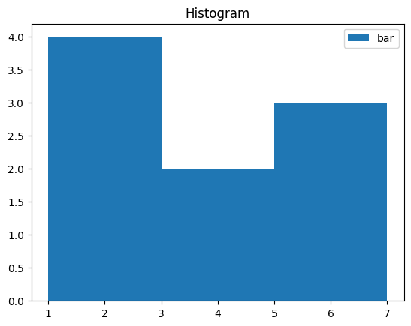
Histogram
import matplotlib.pyplot as plt
# data to display on plots
x = [1, 2, 2,1,4, 5, 6, 6,4]
# This will plot a simple histogram
plt.hist(x, bins =[1, 3,5, 7])
# Title to the plot
plt.title("Histogram")
# Adding the legends
plt.legend(["bar"])
plt.show()

Slide 37
Box plot - Whisker plot
Statistical graph used on sets of numerical data
Shows the range, spread , and center
Used to compare data from different categories

Slide 38

Seaborn
Seaborn package is built on matplotlib but provides high level interface for drawing attractive statistical graphics
It specifically targets statistical data visualization
import seaborn as sns

Slide 39
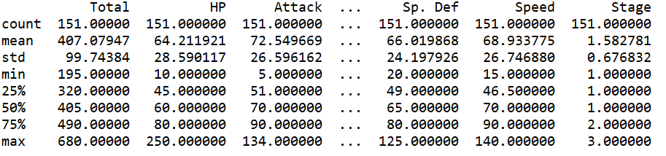
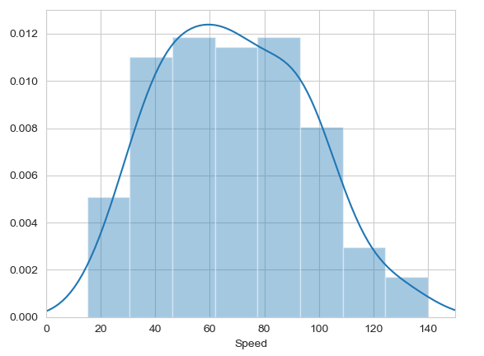

Histograms
Allow you to plot the distributions of numeric variables.

Slide 40
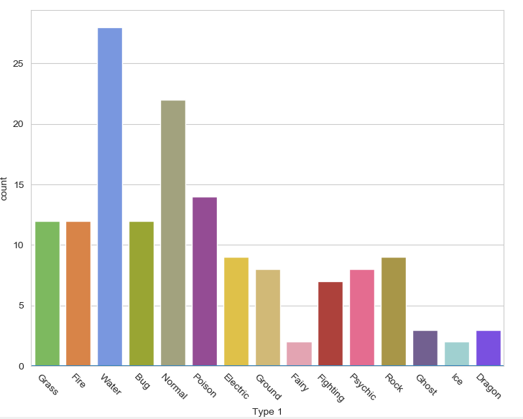

Bar plot
Visualises the distributions of categorical variables.

Slide 41
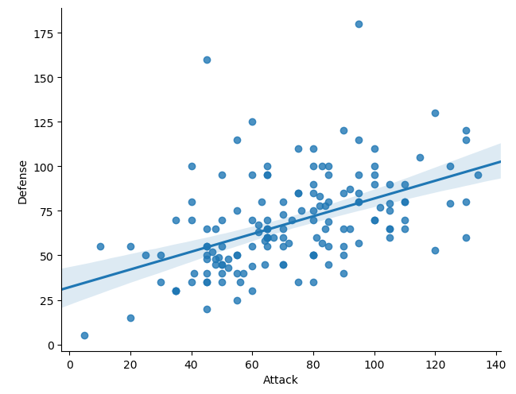
Other types of graphs: Creating a scatter plot
Name of our dataframe fed to the “data=“ command
Name of variable we want on the x-axis
Seaborn “linear model plot” function for creating a scatter graph
Name of variable we want on the y-axis

Slide 42
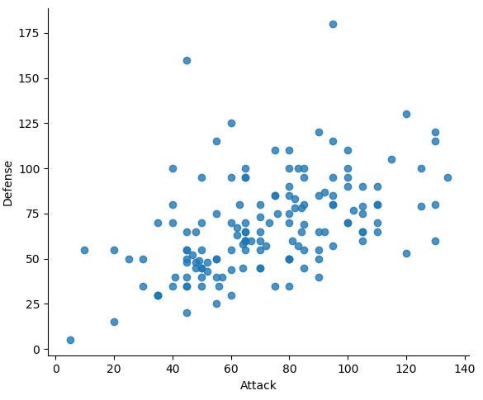
Scatter plot
Seaborn doesn't have a dedicated scatter plot function.
lmplot() function for fitting and plotting a regression line
To remove the regression line, use the fit_reg=False command

Slide 43
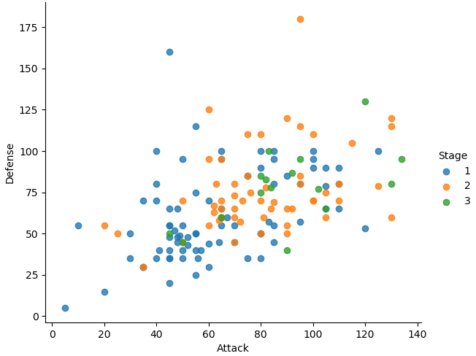

The hue function
Another useful function in Seaborn is the hue function, which enables us to use a variable to colour code our data points.

Slide 44
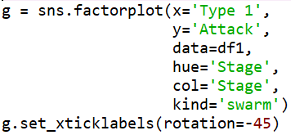
Factor plots
Make it easy to separate plots by categorical classes.
Colour by stage.
Separate by stage.
Generate using a swarmplot.
Rotate axis on x-ticks by 45 degrees.

Slide 45
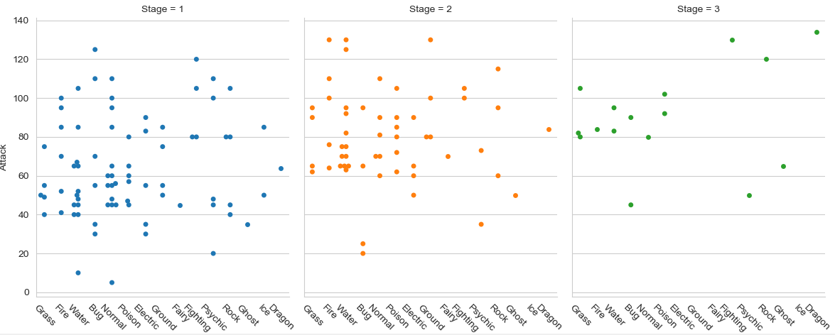

Slide 46
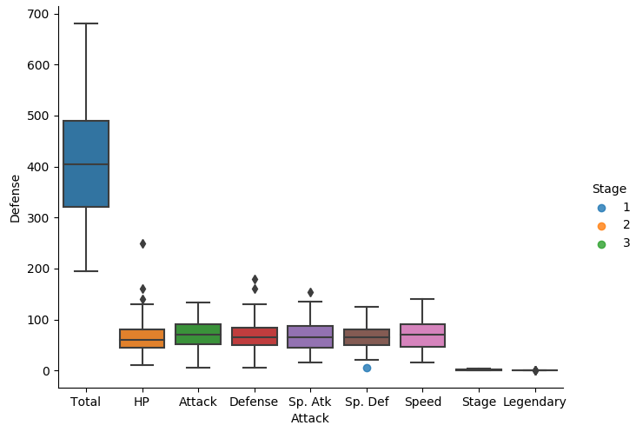

A box plot

Slide 47
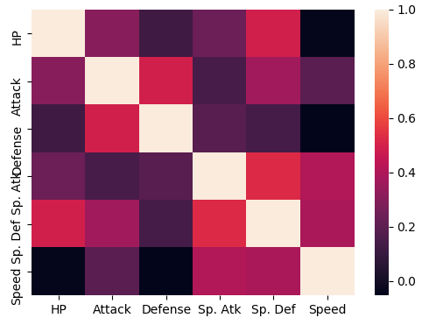

Heatmaps
Useful for visualising matrix-like data.
Here, we’ll plot the correlation of the stats_df variables

Slide 48
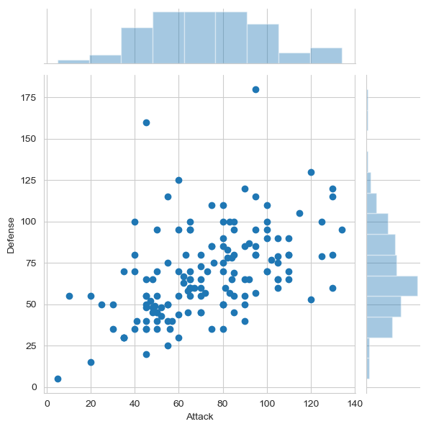

Joint Distribution Plot
Joint distribution plots combine information from scatter plots and histograms to give you detailed information for bi-variate distributions.

Slide 49

Introduction to Plotly
Plotly is a high-level data visualization library that provides a wide range of interactive and customizable chart types. Unlike Matplotlib's pyplot module, which uses a MATLAB-style interface, Plotly follows an object-oriented approach, where each chart is an independent object.
import plotly.graph_objects as go
import plotly.express as px

Slide 50
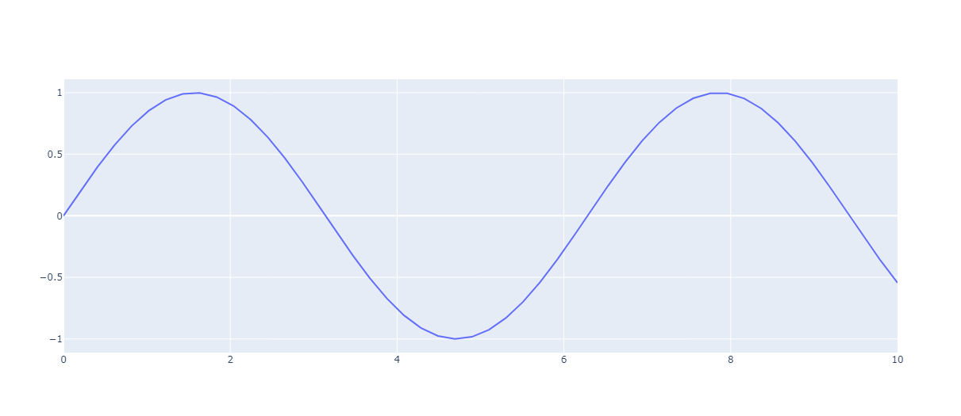
plotly
import plotly.graph_objects as go
import plotly.express as px
import numpy as np
# Generate sample data
x = np.linspace(0, 10, 50)
y = np.sin(x)
# Create the line plot
fig = go.Figure(data=go.Scatter(x=x, y=y))
fig.show()
Or:
# Create the line plot using plotly.express
fig = px.line(x=x, y=y)
fig.show(

Slide 51
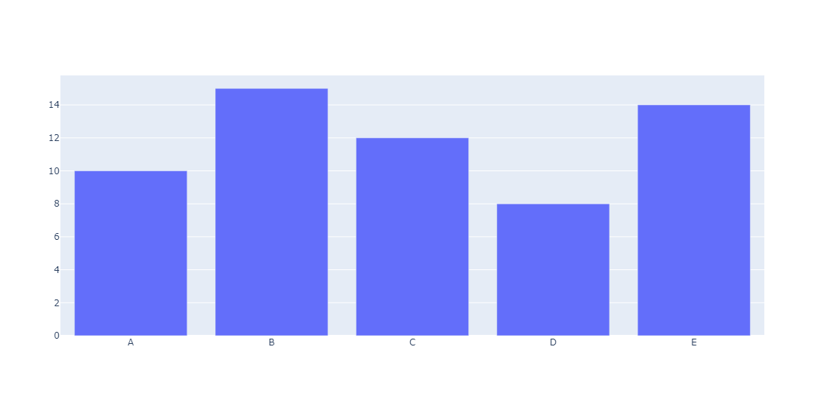
plotly
#Bar Plots
# Generate sample data
categories = ['A', 'B', 'C', 'D', 'E']
values = [10, 15, 12, 8, 14]
# Create the bar plot
fig = go.Figure(data=go.Bar(x=categories, y=values))
fig.show()
#You can also use the px.bar() function:

Slide 52
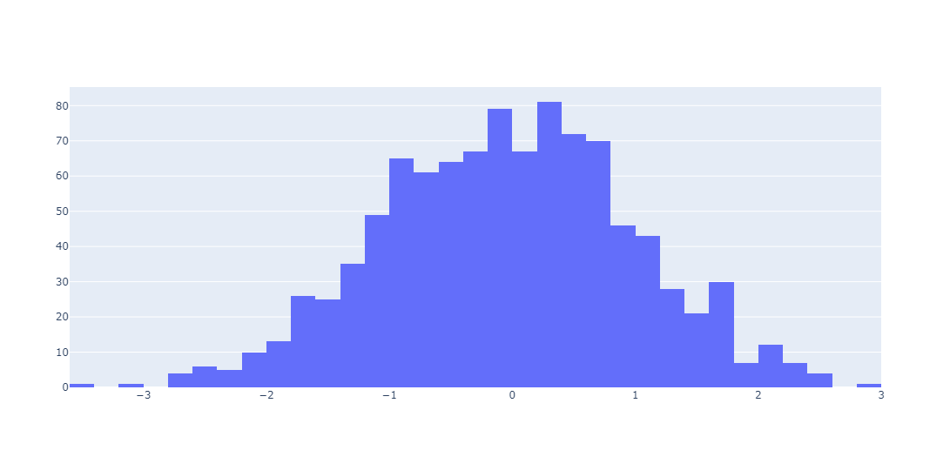
plotly
# Generate sample data
data = np.random.normal(0, 1, 1000)
# Create the histogram
fig = go.Figure(data=go.Histogram(x=data))
fig.show()
#Or use the px.histogram() function:

Slide 53
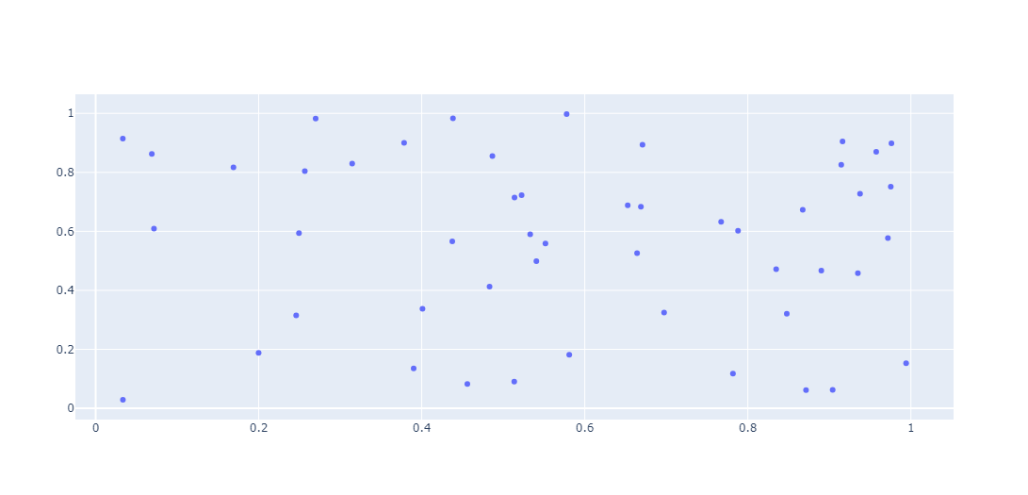
plotly
#Scatter Plots
#To create a scatter plot, you can use the go.Scatter() function with mode='markers':
# Generate sample data
x = np.random.rand(50)
y = np.random.rand(50)
# Create the scatter plot
fig = go.Figure(data=go.Scatter(x=x, y=y, mode='markers'))
fig.show()

Slide 54
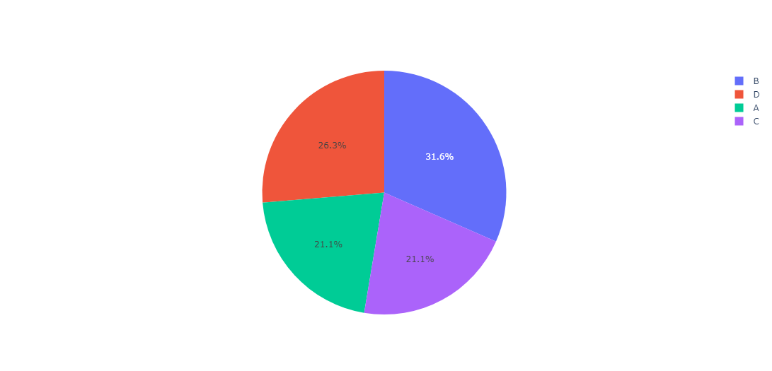
plotly
#Pie Charts
#To create a pie chart, you can use the go.Pie() function:
# Generate sample data
labels = ['A', 'B', 'C', 'D']
values = [20, 30, 20, 25]
# Create the pie chart
fig = go.Figure(data=[go.Pie(labels=labels, values=values)])
fig.show()

